Slide 1
Exercise for Lecture 01

Slide 2
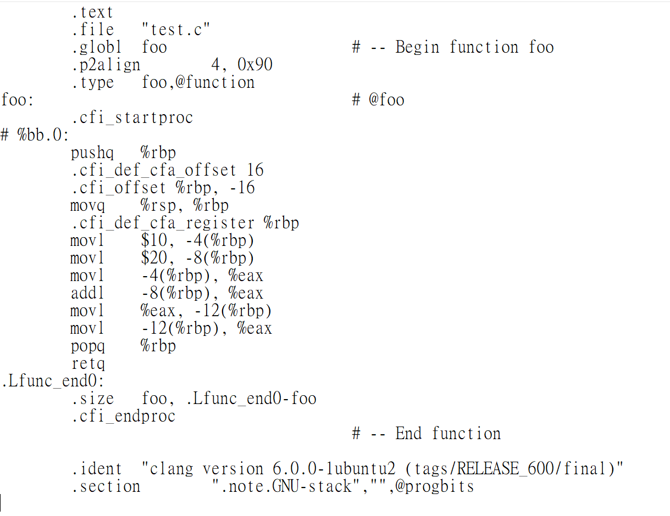
Exercise 1 – Part A
clang –S test.c
int foo ()
{
int a, b, c;
a = 10;
b = 20;
c = a+b;
return c;
}

Slide 3
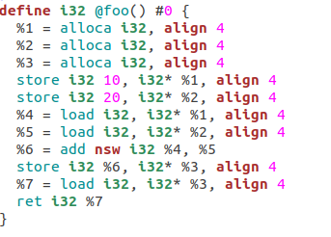
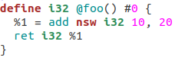
Exercise 1 – Part B
clang -Xclang -disable-O0-optnone –c –emit-llvm test.c
llvm-dis test.bc
opt –mem2reg test.bc –o test01.bc
llvm-dis test01.bc

Slide 4
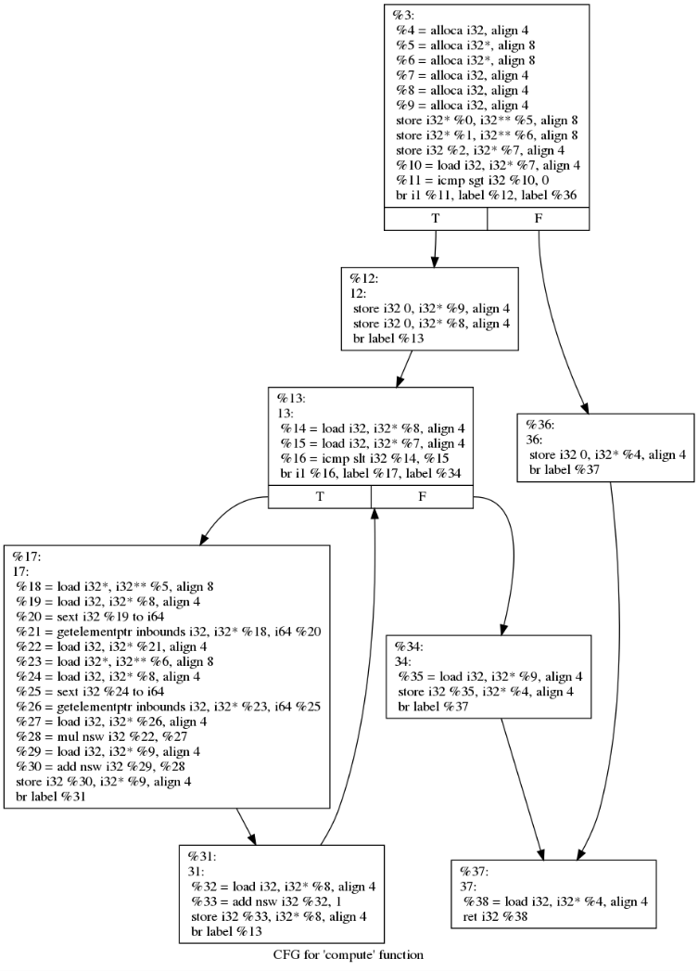
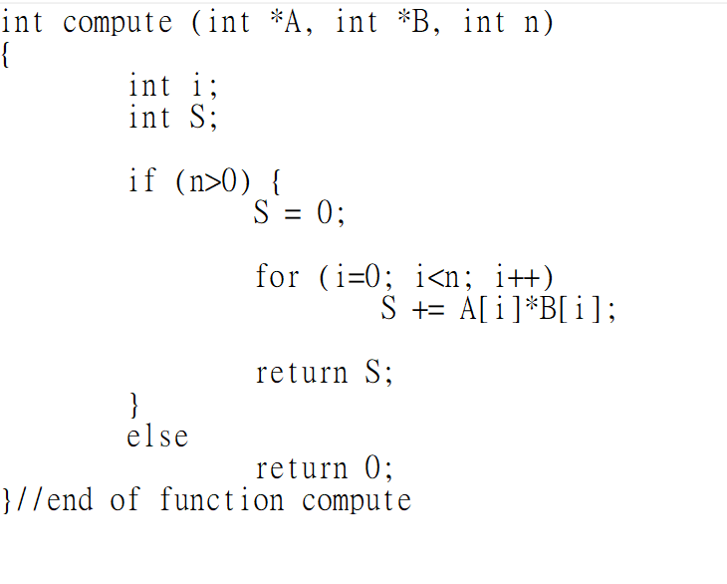
Exercise 2

